Slide 1
CSE 4615:: Wireless Networks
Understanding Wireless Communication: Needs, Barriers, and Design Adaptations
Lecture 1
Course Teacher:
Ashraful Alam Khan
Assistant Professor, CSE, IUT
Content Contributors:
Kyle Jamieson and Jennifer Rexford, Princeton University
Elisabeth Uhlemann, Mälardalens University
Volkan Rodoplu, UCSB

Slide 2
What You Learn in This Course
How does a Wireless Network Work?
What are the Limitations of Wireless Communications?
How to Address These Limitations to Boost Communication Performance?

Slide 3
Structure of the Course
Wireless Access Networks
Wireless Communication Fundamental
Radio Transmission Fundamentals
Radio Spectrum Regulation
Communication Requirements
Mesh Networking Basic
Wireless LAN (IEEE 802.11)
VANET (IEEE 802.11p)
Personal Area Network (IEEE 802.15)
Wireless Mobile Network (5g , LTE)
High Throughput (HT) Networks (IEEE 802.11n, MIMO)
Advanced Techniques for Wireless Communication
Semantic Communication
ML & AI in Wireless Communications

Slide 4
Recourses of the Course
Classroom Code: 3tj4qv4w
Invitation Link: https://classroom.google.com/c/Nzc3NjUyNjIwNDE1?cjc=3tj4qv4w
Book Title | Authors
IEEE 802 Wireless Systems, 1st Edition (Wiley) | B. H. Walke, S. Mangold and L. Berlemann
Wireless Communication Networks and Systems by, 1^{stEd} | Beard and Stallings
Wireless Communications, 2nd Edition | Andrea Goldsmith
Wireless Communications and Networks, 2nd Edition | William Stallings

Slide 5
Fundamentals of Communications
Understanding Wireless Communication:
Objective: move a message from point A to point B with the required quality at a minimum cost with respect to certain design criteria
Message: typically, a number of packets or bits
Quality measures
error probability, e.g., bit or packet or message error rate
delay: time from when information is available at transmitter until it is output from the receiver
data rate: number of transmitted bits/second
Resources and costs
power of transmitted signal (power efficiency)
bandwidth of transmitted signal (spectral efficiency)
complexity of transmitter and receiver (hardware and software)

Slide 6
How do wireless and wired networks differ?

Slide 7
Wired Vs. Wireless Communication
Wired | Wireless
Each cable is a different channel
One media (cable) shared by all
Signal attenuation is low
High signal attenuation
High interference
noise; co-channel interference; adjacent channel interference
Low interference (Cross-talk)

Slide 8
Wired Vs. Wireless Communication
Parameter | Wired Network | Wireless Network
Communication Medium | Copper, Fiber optic | Air (Radio Waves)
Standard | IEEE 802.3 (Ethernet) | IEEE 802.11 family (Wi-Fi)
Mobility & Roaming | Limited | High
Security ? | High (less vulnerable to attacks) | Lower (prone to eavesdropping/hacking)
Speed / Bandwidth | Very High (up to 1 Gbps or more) | Moderate to Low
Delay (Latency) | Low | High
Reliability | Very High | Less reliable
Flexibility to Change | Rigid setup, hard to reconfigure | Highly flexible
Working Principle | CSMA/CD (Collision Detection) | CSMA/CA (Collision Avoidance)
Interference / Fluctuations | Very Low | High (affected by walls, devices, etc.)
Installation Activity | Cumbersome; labor-intensive | Easy; minimal labor
Installation Time | Long (due to cabling, physical setup) | Quick deployment
Connection Type | Usually Dedicated | Shared
Installation Cost | High (cables, labor, devices) | Low
Maintenance Cost | High | Low
Related Equipment | Router, Switch, Hub | Wireless Router, Access Point
Key Benefits | High speed, stable, secure, noise-immune | Cable-free, mobile-friendly, easy to install

Slide 9
Wired Vs. Wireless Communication
Parameter | Wired Network | Wireless Network
Communication Medium | Copper, Fiber optic | Air (Radio Waves)
Standard | IEEE 802.3 (Ethernet) | IEEE 802.11 family (Wi-Fi)
Mobility & Roaming | Limited | High
Security | High (less vulnerable to attacks) | Lower (prone to eavesdropping/hacking)
Speed / Bandwidth ? | Very High (up to 1 Gbps or more) | Moderate to Low
Delay (Latency) ? | Low | High
Reliability | Very High | Less reliable
Flexibility to Change | Rigid setup, hard to reconfigure | Highly flexible
Working Principle | CSMA/CD (Collision Detection) | CSMA/CA (Collision Avoidance)
Interference / Fluctuations | Very Low | High (affected by walls, devices, etc.)
Installation Activity | Cumbersome; labor-intensive | Easy; minimal labor
Installation Time | Long (due to cabling, physical setup) | Quick deployment
Connection Type | Usually Dedicated | Shared
Installation Cost | High (cables, labor, devices) | Low
Maintenance Cost | High | Low
Related Equipment | Router, Switch, Hub | Wireless Router, Access Point
Key Benefits | High speed, stable, secure, noise-immune | Cable-free, mobile-friendly, easy to install

Slide 10
Wired Vs. Wireless Communication
Parameter | Wired Network | Wireless Network
Communication Medium | Copper, Fiber optic | Air (Radio Waves)
Standard | IEEE 802.3 (Ethernet) | IEEE 802.11 family (Wi-Fi)
Mobility & Roaming | Limited | High
Security | High (less vulnerable to attacks) | Lower (prone to eavesdropping/hacking)
Speed / Bandwidth | Very High (up to 1 Gbps or more) | Moderate to Low
Delay (Latency) | Low | High
Reliability ? | Very High | Less reliable
Flexibility to Change | Rigid setup, hard to reconfigure | Highly flexible
Working Principle | CSMA/CD (Collision Detection) | CSMA/CA (Collision Avoidance)
Interference / Fluctuations | Very Low | High (affected by walls, devices, etc.)
Installation Activity | Cumbersome; labor-intensive | Easy; minimal labor
Installation Time | Long (due to cabling, physical setup) | Quick deployment
Connection Type | Usually Dedicated | Shared
Installation Cost | High (cables, labor, devices) | Low
Maintenance Cost | High | Low
Related Equipment | Router, Switch, Hub | Wireless Router, Access Point
Key Benefits | High speed, stable, secure, noise-immune | Cable-free, mobile-friendly, easy to install

Slide 11
Wired Vs. Wireless Communication
Parameter | Wired Network | Wireless Network
Communication Medium | Copper, Fiber optic | Air (Radio Waves)
Standard | IEEE 802.3 (Ethernet) | IEEE 802.11 family (Wi-Fi)
Mobility & Roaming | Limited | High
Security | High (less vulnerable to attacks) | Lower (prone to eavesdropping/hacking)
Speed / Bandwidth | Very High (up to 1 Gbps or more) | Moderate to Low
Delay (Latency) | Low | High
Reliability | Very High | Less reliable
Flexibility to Change ? | Rigid setup, hard to reconfigure | Highly flexible
Working Principle ? | CSMA/CD (Collision Detection) | CSMA/CA (Collision Avoidance)
Interference / Fluctuations | Very Low | High (affected by walls, devices, etc.)
Installation Activity | Cumbersome; labor-intensive | Easy; minimal labor
Installation Time | Long (due to cabling, physical setup) | Quick deployment
Connection Type | Usually Dedicated | Shared
Installation Cost | High (cables, labor, devices) | Low
Maintenance Cost | High | Low
Related Equipment | Router, Switch, Hub | Wireless Router, Access Point
Key Benefits | High speed, stable, secure, noise-immune | Cable-free, mobile-friendly, easy to install

Slide 12
Wired Vs. Wireless Communication
Parameter | Wired Network | Wireless Network
Communication Medium | Copper, Fiber optic | Air (Radio Waves)
Standard | IEEE 802.3 (Ethernet) | IEEE 802.11 family (Wi-Fi)
Mobility & Roaming | Limited | High
Security | High (less vulnerable to attacks) | Lower (prone to eavesdropping/hacking)
Speed / Bandwidth | Very High (up to 1 Gbps or more) | Moderate to Low
Delay (Latency) | Low | High
Reliability | Very High | Less reliable
Flexibility to Change | Rigid setup, hard to reconfigure | Highly flexible
Working Principle | CSMA/CD (Collision Detection) | CSMA/CA (Collision Avoidance)
Interference / Fluctuations ? | Very Low | High (affected by walls, devices, etc.)
Installation Activity | Cumbersome; labor-intensive | Easy; minimal labor
Installation Time | Long (due to cabling, physical setup) | Quick deployment
Connection Type | Usually Dedicated | Shared
Installation Cost | High (cables, labor, devices) | Low
Maintenance Cost | High | Low
Related Equipment | Router, Switch, Hub | Wireless Router, Access Point
Key Benefits | High speed, stable, secure, noise-immune | Cable-free, mobile-friendly, easy to install

Slide 13
Wired Vs. Wireless Communication
Parameter | Wired Network | Wireless Network
Communication Medium | Copper, Fiber optic | Air (Radio Waves)
Standard | IEEE 802.3 (Ethernet) | IEEE 802.11 family (Wi-Fi)
Mobility & Roaming | Limited | High
Security | High (less vulnerable to attacks) | Lower (prone to eavesdropping/hacking)
Speed / Bandwidth | Very High (up to 1 Gbps or more) | Moderate to Low
Delay (Latency) | Low | High
Reliability | Very High | Less reliable
Flexibility to Change | Rigid setup, hard to reconfigure | Highly flexible
Working Principle | CSMA/CD (Collision Detection) | CSMA/CA (Collision Avoidance)
Interference / Fluctuations | Very Low | High (affected by walls, devices, etc.)
Installation Activity ? | Cumbersome; labor-intensive | Easy; minimal labor
Installation Time ? | Long (due to cabling, physical setup) | Quick deployment
Connection Type ? | Usually Dedicated | Shared
Installation Cost | High (cables, labor, devices) | Low
Maintenance Cost | High | Low
Related Equipment | Router, Switch, Hub | Wireless Router, Access Point
Key Benefits | High speed, stable, secure, noise-immune | Cable-free, mobile-friendly, easy to install

Slide 14
Wired Vs. Wireless Communication
Parameter | Wired Network | Wireless Network
Communication Medium | Copper, Fiber optic | Air (Radio Waves)
Standard | IEEE 802.3 (Ethernet) | IEEE 802.11 family (Wi-Fi)
Mobility & Roaming | Limited | High
Security | High (less vulnerable to attacks) | Lower (prone to eavesdropping/hacking)
Speed / Bandwidth | Very High (up to 1 Gbps or more) | Moderate to Low
Delay (Latency) | Low | High
Reliability | Very High | Less reliable
Flexibility to Change | Rigid setup, hard to reconfigure | Highly flexible
Working Principle | CSMA/CD (Collision Detection) | CSMA/CA (Collision Avoidance)
Interference / Fluctuations | Very Low | High (affected by walls, devices, etc.)
Installation Activity | Cumbersome; labor-intensive | Easy; minimal labor
Installation Time | Long (due to cabling, physical setup) | Quick deployment
Connection Type | Usually Dedicated | Shared
Installation Cost ? | High (cables, labor, devices) | Low
Maintenance Cost ? | High | Low
Related Equipment ? | Router, Switch, Hub | Wireless Router, Access Point
Key Benefits | High speed, stable, secure, noise-immune | Cable-free, mobile-friendly, easy to install

Slide 15
Wired Vs. Wireless Communication
Parameter | Wired Network | Wireless Network
Communication Medium | Copper, Fiber optic | Air (Radio Waves)
Standard | IEEE 802.3 (Ethernet) | IEEE 802.11 family (Wi-Fi)
Mobility & Roaming | Limited | High
Security | High (less vulnerable to attacks) | Lower (prone to eavesdropping/hacking)
Speed / Bandwidth | Very High (up to 1 Gbps or more) | Moderate to Low
Delay (Latency) | Low | High
Reliability | Very High | Less reliable
Flexibility to Change | Rigid setup, hard to reconfigure | Highly flexible
Working Principle | CSMA/CD (Collision Detection) | CSMA/CA (Collision Avoidance)
Interference / Fluctuations | Very Low | High (affected by walls, devices, etc.)
Installation Activity | Cumbersome; labor-intensive | Easy; minimal labor
Installation Time | Long (due to cabling, physical setup) | Quick deployment
Connection Type | Usually Dedicated | Shared
Installation Cost | High (cables, labor, devices) | Low
Maintenance Cost | High | Low
Related Equipment | Router, Switch, Hub | Wireless Router, Access Point
Key Benefits ? | High speed, stable, secure, noise-immune | Cable-free, mobile-friendly, easy to install

Slide 16
Wired Vs. Wireless Communication
Parameter | Wired Network | Wireless Network
Communication Medium | Copper, Fiber optic | Air (Radio Waves)
Standard | IEEE 802.3 (Ethernet) | IEEE 802.11 family (Wi-Fi)
Mobility & Roaming | Limited | High
Security | High (less vulnerable to attacks) | Lower (prone to eavesdropping/hacking)
Speed / Bandwidth | Very High (up to 1 Gbps or more) | Moderate to Low
Delay (Latency) | Low | High
Reliability | Very High | Less reliable
Flexibility to Change | Rigid setup, hard to reconfigure | Highly flexible
Working Principle | CSMA/CD (Collision Detection) | CSMA/CA (Collision Avoidance)
Interference / Fluctuations | Very Low | High (affected by walls, devices, etc.)
Installation Activity | Cumbersome; labor-intensive | Easy; minimal labor
Installation Time | Long (due to cabling, physical setup) | Quick deployment
Connection Type | Usually Dedicated | Shared
Installation Cost | High (cables, labor, devices) | Low
Maintenance Cost | High | Low
Related Equipment | Router, Switch, Hub | Wireless Router, Access Point
Key Benefits | High speed, stable, secure, noise-immune | Cable-free, mobile-friendly, easy to install

Slide 17
Wired Vs. Wireless Communication
Parameter | Wired Network | Wireless Network
Communication Medium | Copper, Fiber optic | Air (Radio Waves)
Standard | IEEE 802.3 (Ethernet) | IEEE 802.11 family (Wi-Fi)
Mobility & Roaming | Limited | High
Security | High (less vulnerable to attacks) | Lower (prone to eavesdropping/hacking)
Speed / Bandwidth | Very High (up to 1 Gbps or more) | Moderate to Low
Delay (Latency) | Low | High
Reliability | Very High | Less reliable
Flexibility to Change | Rigid setup, hard to reconfigure | Highly flexible
Working Principle | CSMA/CD (Collision Detection) | CSMA/CA (Collision Avoidance)
Interference / Fluctuations | Very Low | High (affected by walls, devices, etc.)
Installation Activity | Cumbersome; labor-intensive | Easy; minimal labor
Installation Time | Long (due to cabling, physical setup) | Quick deployment
Connection Type | Usually Dedicated | Shared
Installation Cost | High (cables, labor, devices) | Low
Maintenance Cost | High | Low
Related Equipment | Router, Switch, Hub | Wireless Router, Access Point
Key Benefits | High speed, stable, secure, noise-immune | Cable-free, mobile-friendly, easy to install
How to Address These Limitations of Wireless Networks
to Boost Communication Performance?

Slide 18
What Are the Limitations of Wireless Communications?
Limitation | Description
Susceptible to Interference | From other wireless devices or physical obstacles (walls, appliances).
Signal Attenuation & Fading | Signals weaken over distance and vary due to multipath propagation.
Bandwidth Limitations | Shared medium leads to congestion and reduced throughput.
Mobility-Induced Handover Delays | Switching between access points can cause latency or packet loss.
Power Constraints | Battery-operated devices must optimize transmission to save power.
Security Vulnerabilities | Easier to intercept or attack (e.g., spoofing, eavesdropping).

Slide 19
Embracing Wireless: Key Motivations
Advantages
Eliminates the need for physical cabling in difficult or remote areas
Enables user mobility and flexible access
Lower installation cost in many environments

Slide 20
How to Address These Limitations to Boost Communication Performance?
Challenge | Solutions
Interference | Use directional antennas, adaptive frequency selection, and smart AP placement.
Signal Attenuation | Deploy MIMO, repeaters, and mesh networks for better coverage.
Bandwidth Sharing | Cognitive Radio for Spectrum Sharing, Apply QoS (Quality of Service)
Handover Delays | Use fast handoff techniques and mobile IP support for seamless mobility.
Power Efficiency | Use energy-aware MAC protocols and sleep cycles.
Security Threats | Implement WPA3, VPNs, firewalls, and regular firmware updates.

Slide 21
Wireless Wireless links characteristics

Slide 22
Understanding Wireless Links
Tx
Rx
How does signal propagate ?
How much attenuation take place ?
How does signal look like at the receiver ?

Slide 23
Wireless Link Characteristics
Wireless is a broadcast medium!
Differences from wired link ….
decreased signal strength: radio signal attenuates as it propagates through matter (path loss)
Signal Strength
space

Slide 24
Wireless Link Characteristics
Wireless is a broadcast medium!
Differences from wired link ….
decreased signal strength: radio signal attenuates as it propagates through matter (path loss)
interference from other sources: standardized wireless network frequencies (e.g., 2.4 GHz) shared by other devices (e.g., phone); devices (motors, microwaves) interfere as well
Signal Strength
space

Slide 25
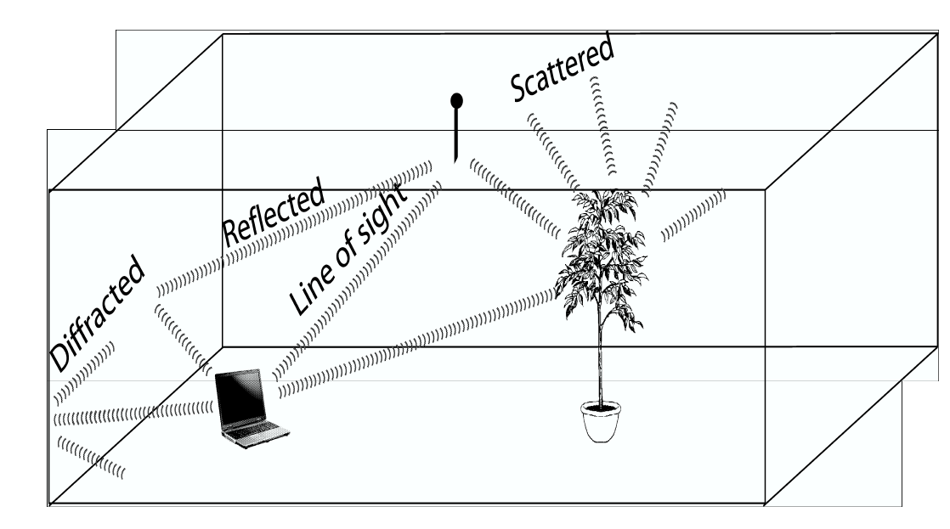
Wireless Link Characteristics
Wireless is a broadcast medium!
Differences from wired link ….
multipath propagation (fading): radio signal reflects off objects or ground, arriving at destination at slightly different times
Reflection
Diffraction
Scattering

Slide 26

Wireless Link Characteristics
Wireless is a broadcast medium!
Differences from wired link ….
decreased signal strength:
interference from other sources:
multipath propagation (fading):
Reflection
Diffraction
Scattering
Signal Strength
space
…. make communication across (even a point to point) wireless link much more “difficult”

Slide 27
Impact of Multipath Propagation
Direct signal
Reflected signal
Received signal

Slide 28
Wireless Link Characteristics– Fading
Channel characteristics change over time and location
e.g., movement of sender, receiver and/or scatters
➔ quick changes in the power received (short term/fast fading)
➔ slow changes in the average power received (long term/slow fading)
long term
fading
power
t
short term fading
Notes:
Fast fading: usually observed over distances of about half a wavelength. For VHF and UHF, a vehicle traveling at 30 miles per hour can pass through several fast fades in a second
Slow fading: movement over distances large enough to produce gross variations in the overall path

Slide 29
Wireless Link Characteristics– Fading
10 W
Sample Example
10¹
P₁
Path loss in decibel,
dB = 10 log (----)
P₂
Where:
P₁ ​ = Transmitted Power
P₂ ​ = Received Power
Power
Path loss from source to d2 = 70dB
10⁻³
1 mW
10,000 times
1,000 times
40 dB
30 dB
1 μW
10⁻⁶
source
d1
d2

Slide 30
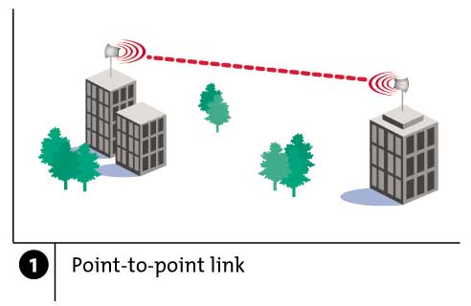
Wireless Link Characteristics– Fading
To convert power from milliwatts (mW) to decibel-milliwatts (dBm), use the formula:
P (dBm) = 10 · log10(P (mW))
If,
Transmitted Signal Power: P_{tx} decibel-milliwatts (dBm)
Receiver Sensitivity: P_{rx} decibel-milliwatts (dBm)
Maximum Tolerable Path Loss = P_{tx} (dBm) − P_{rx} (dBm)

Slide 31
Typical Picture
Received
Signal
Power
(dBm)
path loss
slow fading
fast fading
log (distance)
Notes:
Pt = PrGtGr (λ/4pR)^2

Slide 32
Attenuation
Strength of signal falls off with distance over transmission medium
Attenuation factors for unguided media:
Received signal must have sufficient strength so that circuitry in the receiver can interpret the signal
Signal must maintain a level sufficiently higher than noise to be received without error
Attenuation is greater at higher frequencies, causing distortion
Approach: amplifiers that strengthen higher frequencies

Slide 33
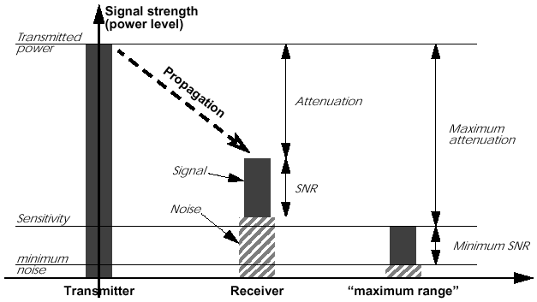
Attenuation: Propagation & Range

Slide 34
Signal Propagation Ranges
Transmission range
communication possible
low error rate
Detection range
detection of the signal possible
no communication possible
Interference range
signal may not be detected
signal adds to the background noise
sender
transmission
distance
detection
interference
Notes:
These ranges are not circular in the real world.

Slide 35
Signal, Noise, and Interference
Signal (S)
Noise (N)
Includes thermal noise and background radiation
Interference (I)
Signals from other transmitting sources
SINR = S/(N+I) (sometimes also denoted as SNR)
Large SINR = easier to extract signal from noise

Slide 36
dB and Power conversion
dB
Denote the difference between two power levels
(P2/P1)[dB] = 10 * log10 (P2/P1)
P2/P1 = 10^(A/10)
Example 1: P2 = 10 P1, P2/P1=10dB
Example 2: P2/P1 = 33dB, P2 = 2000 P1
dBm and dBW
Denote the power level relative to 1 mW or 1 W
P[dBm] = 10*log10(P/1mW)
P[dBW] = 10*log10(P/1W)
Example: P = 0.001mW = -30dBm, P = 100W = 20dBW
10dB: factor of 10
3dB: factor of 2

Slide 37
Wireless Link Characteristics
SNR: signal-to-noise ratio
larger SNR – easier to extract signal from noise
SNR versus BER tradeoffs
given physical layer: increase power -> increase SNR->decrease BER
given SNR: choose physical layer that meets BER requirement, giving highest throughput
10⁻¹
10⁻²
10⁻³
BER
10⁻⁴
10⁻⁵
10⁻⁶
10⁻⁷
10
20
30
40
SNR(dB)
QAM256 (8 Mbps)
QAM16 (4 Mbps)
BPSK (1 Mbps)

Slide 38
Rate Adaptation
base station, mobile dynamically change transmission rate (physical layer modulation technique) as mobile moves, SNR varies
10⁻¹
10⁻²
10⁻³
BER
10⁻⁴
10⁻⁵
10⁻⁶
10⁻⁷
10
20
30
40
SNR(dB)
1. SNR decreases, BER increase as node moves away from base station
QAM256 (8 Mbps)
QAM16 (4 Mbps)
BPSK (1 Mbps)
operating point
2. When BER becomes too high, switch to lower transmission rate but with lower BER

Slide 39
Understanding Wireless Communication: Barriers

Slide 40

Wireless is less reliable
Alice
Bob
In wired networks, link bit error rate is 10⁻¹² and less
Wireless networks are far from that target
– Bit error rates of 10⁻⁶ and above are common!
Why?

Slide 41


Wireless is a shared medium
Cathy
Wired networks:
Alice and Bob’s conversation is independent of Cathy and Eve’s conversation
Alice
Bob
Eve
Wireless networks:
Close by wireless conversations share the same wireless medium

Slide 42
Wireless Links: High Bit Error Rate
“Wireless communication often faces disruptions from the environment, causing more errors in the received data, known as a high Bit Error Rate (BER).”
Factors Contributing to High BER::
Signal Attenuation:
Signal gets weaker with distance or obstacles, making it harder to receive clearly.
Noise and Interference:
Other electronic signals mix with the intended one, causing data errors.
Multipath Fading & Environmental Obstructions:
Reflected signals arrive at different times, distorting the original message.
Doppler Shift (Mobility):
Movement causes frequency changes, making signal decoding difficult.
Broadcast Limitations at Wireless Links

Slide 43
Dealing With Bit Errors
Wireless vs. wired links
Wired: most loss is due to congestion
Wireless: higher, time-varying bit-error ate
Dealing with high bit-error rates
Sender could increase transmission power
Requires more energy (bad for battery-powered hosts)
Creates more interference with other senders
Stronger error detection and recovery
More powerful error detection codes
Link-layer retransmission of corrupted frames

Slide 44
1. Signal Attenuation

Slide 45
1. Signal Attenuation
Signal Attenuation:: Decreasing signal strength
Disperses as it travels greater distance
Attenuates as it passes through matter

Slide 46
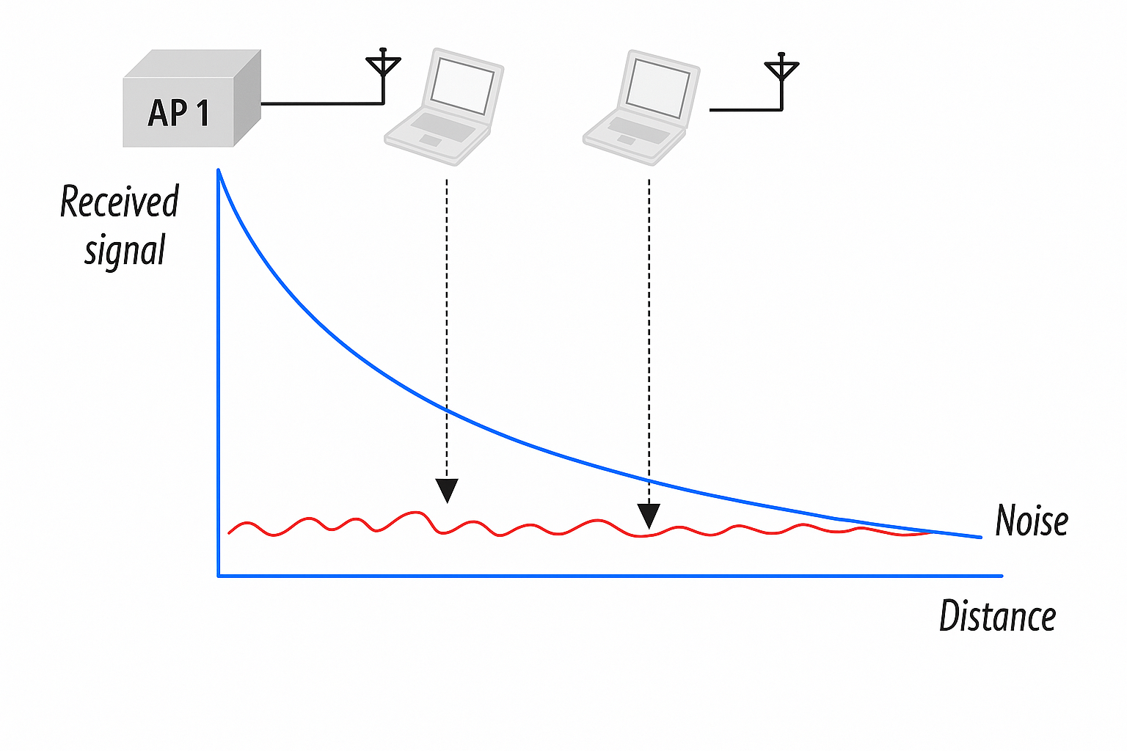
1.Signal Attenuation:: High BER
Decreasing signal strength
Disperses as it travels greater distance
Attenuates as it passes through matter
Metal particles present in air
Noice and interference
Lower signal-to-noise ratio (SNR) increases the probability of bit errors

Slide 47
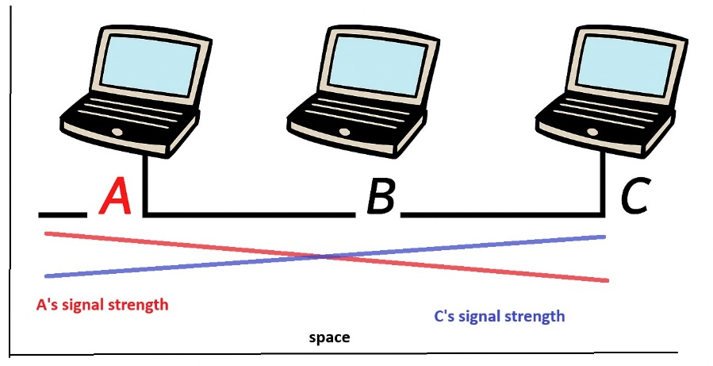
1.Signal Attenuation
Received Signal Strength:: Wired vs Wireless
Received Signal Strength in Wired Networks
Received Signal Strength in Wireless Networks
A
B
C
A’s signal
strength
C’s signal
strength
space

Slide 48
1.Signal Attenuation
Reason: Minimal Signal Loss in Wired
Signals travel through guided media like copper or fiber.
These media shield signals from external interference and minimize attenuation.
Losses due to resistance or cable imperfections are very small over short-to-moderate distances.
Received Signal Strength in Wired Networks

Slide 49
1.Signal Attenuation
Received Signal Strength in Wireless Networks
Reason: Higher Signal Loss in Wireless
In wireless networks, RSS drops rapidly with distance due to:
Path loss
Obstacles
Noise and interference
A
B
C
A’s signal
strength
C’s signal
strength
space

Slide 50
1.Signal Attenuation
The higher frequencies will
usually encounter more “loss”
in “real world” situations

Slide 51
2. Noise and Interference

Slide 52
Categories of Noise
2. Noise and Interference
Thermal Noise
Intermodulation noise
Occurs when signals at different frequencies mix and produce additional unwanted signals.
Crosstalk
Unwanted signal leakage between adjacent cables or channels.
Impulse Noise
Caused by the random motion of electrons in a conductor.
Present in all electronic devices and transmission media.
Increases with temperature; affects all frequencies uniformly.
Sudden, short-duration high-energy spikes.
Caused by lightning, switching equipment, or power line disturbances.
Particularly harmful to digital communication; can corrupt multiple bits at once.

Slide 53
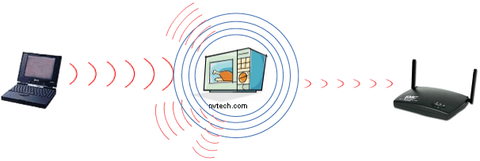
2. Noise and Interference
Interference from other sources
Radio sources in same frequency band
E.g., 2.4 GHz wireless phone interferes with 802.11b wireless LAN
Electromagnetic noise (e.g., microwave oven)

Slide 54
EM Spectrum
ISM band
902 – 928 Mhz
S/W radio
FM radio
TV
2.4 – 2.4835 Ghz
AM radio
TV
cellular
5.725 – 5.785 Ghz
LF
MF
HF
VHF
UHF
SHF
EHF
ν
30kHz
300kHz
3MHz
30MHz
300MHz
3GHz
30GHz
300GHz
10cm
100mm
λ
10km
1km
100m
10m
1m
1cm
X rays
ν
infrared
visible
UV
Gamma rays
1 kHz
1 MHz
1 GHz
1 THz
1 PHz
1 EHz
Propagation characteristics are different in each frequency band

Slide 55
EM Spectrum:: ISM Band
ISM Band (Industrial, Scientific, and Medical Band)
Key Features
License-free usage (no regulatory approval needed, with power limits).
Common in Wi-Fi, Bluetooth, RFID, microwave ovens, and cordless phones.
Operates under power and interference constraints to coexist with other users.
Frequency Band | Common Uses
433 MHz | RFID, remote controls (Europe)
868 MHz / 915 MHz | IoT devices, Zigbee, LPWAN
2.4 GHz | Wi-Fi (802.11b/g/n), Bluetooth, Microwave ovens
5.8 GHz | Wi-Fi (802.11a/n/ac), radar, ISM devices
This can cause interference, especially between Wi-Fi and microwave ovens.
Modern Wi-Fi devices often switch to 5 GHz or 6 GHz to avoid congestion.

Slide 56
2.Noise and Interference:: High BER
How Noise & Interference Increase Bit Error Rate (BER)
Noise (thermal, impulse) distorts the signal, making it hard to detect correct bits.
Interference from nearby devices overlaps signals, causing bit confusion.
Low SNR reduces the receiver’s ability to distinguish between 0s and 1s.

Slide 57
3. Multipath Fading & Environmental Obstructions

Slide 58
The Cluttered World of Radio Waves
hills
girders
rain
hallways
windows
vehicles
trees
walls

Slide 59
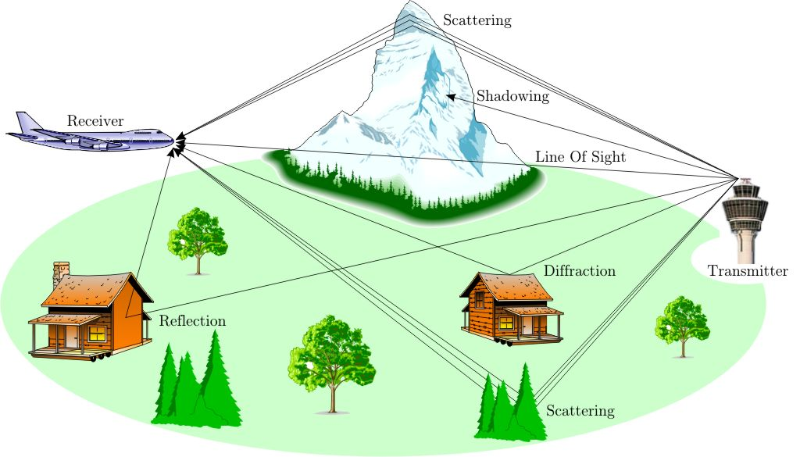
3.Multipath Fading & Environmental Obstructions: High BER
Multi-path propagation
Electromagnetic waves reflect off objects
Taking many paths of different lengths
Causing blurring of signal at the receiver
Multipath fading causes signal distortion and delays, increasing errors (BER).
receiver
transmitter

Slide 60
3.Multipath Fading & Environmental Obstructions: High BER
Three basic propagation mechanisms
Reflection
λ << D
Diffraction
λ ≈ D
Scattering
λ >> D
Propagation effects depend on not only on the specific portion of spectrum used for transmission, but also on the bandwidth (or spectral occupancy) of the signal being transmitted
Spatial separation of Tx-Rx

Slide 61
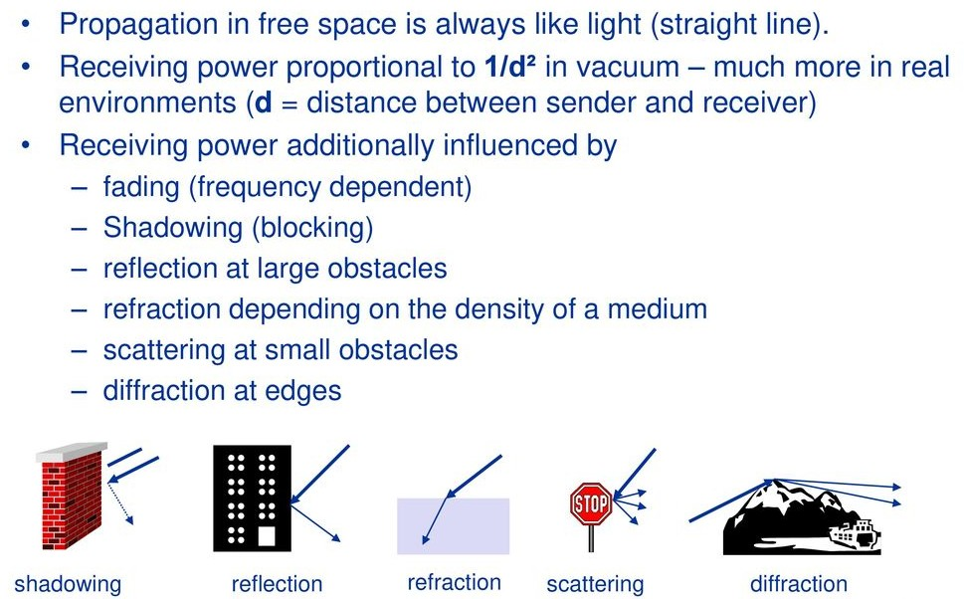
3.Multipath Fading & Environmental Obstructions: High BER

Slide 62
4. Doppler Shift (Mobility):

Slide 63
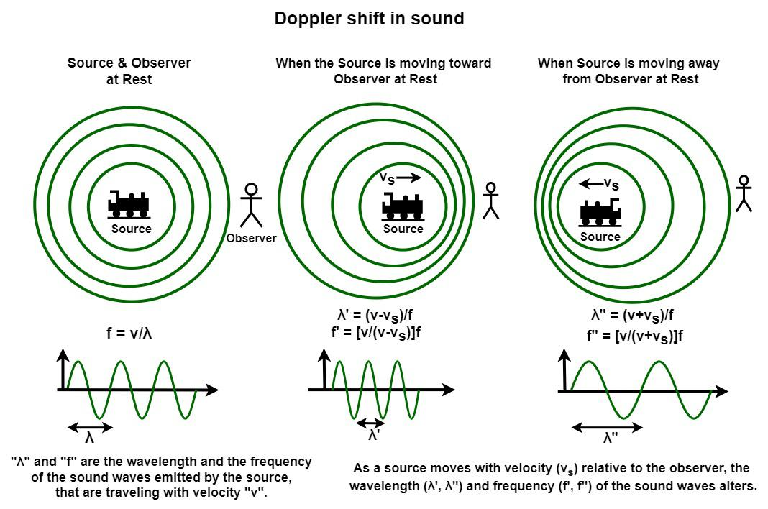
4.Doppler Shift (Mobility):

Slide 64
4.Doppler Shift (Mobility): High BER
Doppler Shift causes frequency changes in the received signal due to relative motion between transmitter and receiver.
This leads to carrier frequency offset and loss of synchronization at the receiver.
It also increases channel variation rate, making the channel time-varying and unpredictable.
As a result, symbols may be misinterpreted, especially in high-speed mobility scenarios.
Impact
→ Distorted signal → Synchronization errors → Higher BER

Slide 65
5. Broadcast Limitations at Wireless Links

Slide 66
5.Wireless Links: Broadcast Limitations
Wired broadcast links
E.g., Ethernet bridging, in wired LANs
All nodes receive transmissions from all other nodes
Wireless broadcast: hidden terminal problem
C
A and B hear each other
B and C hear each other
But, A and C do not
So, A and C are unaware
of their interference at B.
B
A

Slide 67
5.Wireless Links: Broadcast Limitations
Wired broadcast links
E.g., Ethernet bridging, in wired LANs
All nodes receive transmissions from all other nodes
Wireless broadcast: fading over distance
A
B
C
A and B hear each other
B and C hear each other
But, A and C do not
So, A and C are unaware
of their interference at B.
A’s signal
strength
C’s signal
strength
space

Slide 68
5.Wireless Links: Broadcast Limitations
Why is this a problem in wireless networks?
C
B
A
A
B
C
A’s signal
strength
C’s signal
strength
space

Slide 69

5.Wireless Links: Broadcast Limitations
Why is it NOT a problem in wired networks?
In wired networks, like Ethernet:
All nodes are also connected to a shared medium (the wire).
Every device can “hear” all transmissions with acceptable received Signal Strength, so they avoid sending at the same time.
(CSMA/CD) Collision Detection works well because all signals are detectable.
C
B
A

Slide 70
5.Wireless Links: Broadcast Limitations:: High BER
Network Type | Can all devices sense each other? | Hidden Terminal Problem?
Wired | ✅ Yes | ❌ No
Wireless | ❌ Not always | ✅ Yes
Impact
→ Undetected collisions at receiver → Corrupted data → Increased BER
A
B
C
A’s signal
strength
C’s signal
strength
space

Slide 71
Understanding Wireless Communication: Needs, Barriers, and Design Adaptations

Slide 72
Understanding Wireless Communication: Needs

Slide 73




Examples of Communication Requirements
Cell phones:
bit error probability: < 0.1 % delay: < 100 ms data rate: 10-15 kbit/s
E-mailing:
bit error probability: < 10⁻⁹ delay: < 1 day data rate: irrelevant
Mobile broadband:
bit error probability: < 10⁻⁵ delay: < seconds data rate: < 80 Mbit/s

Slide 74
Multimedia Requirements
Voice
Data
Video
Delay
<100ms
-
<100ms
Packet Loss
<1%
0
<1%
BER
10⁻³
10⁻⁶
10⁻⁶
Data Rate
8-32 Kbps
1-100 Mbps
1-20 Mbps
Traffic
Continuous
Bursty
Continuous
One-size-fits-all protocols and design do not work well
Wired networks use this approach, with poor results

Slide 75
Understanding Wireless Communication: Design Adaptations

Slide 76
Possible Design Goals
Maximize the transmission rate
Minimize the probability of error
Minimize the required power
Minimize the required system bandwidth
Maximize system utilization
Minimize system complexity
Minimize communication delay
Some of these goals are in conflict with each other!

Slide 77
Evolution of Current Systems
Recent past
2G Cellular: ~30-70 Kbps.
WLANs: ~10 Mbps.
3G Cellular: ~300 Kbps.
WLANs: ~70 Mbps.
Technology Enhancements
Hardware: Better batteries. Better circuits/processors.
Link: Antennas, modulation, coding, adaptivity, DSP, BW.
Network: Dynamic resource allocation. Mobility support.
Application: Soft and adaptive QoS.

Slide 78
Design Challenges
Wireless channels are a difficult and capacity-limited broadcast communications medium
Traffic patterns, user locations, and network conditions are constantly changing
Applications are heterogeneous with hard constraints that must be met by the network
Energy and delay constraints change design principles across all layers of the protocol stack

Slide 79
OSI Model
Computer Science
Application
Network
Electrical Engineering
Link
PHY
Spectrum
Notes:
Knowledge across layers is necessary to make informed decision.

Slide 80
Crosslayer Design
Hardware
Link
Access
Network
Application
Delay Constraints
Rate Constraints
Energy Constraints
Adapt across design layers
Reduce uncertainty through scheduling
Provide robustness via diversity

